Slide 1
Century Room scheduler
Daniel mcgraw & ryan ward

Slide 2
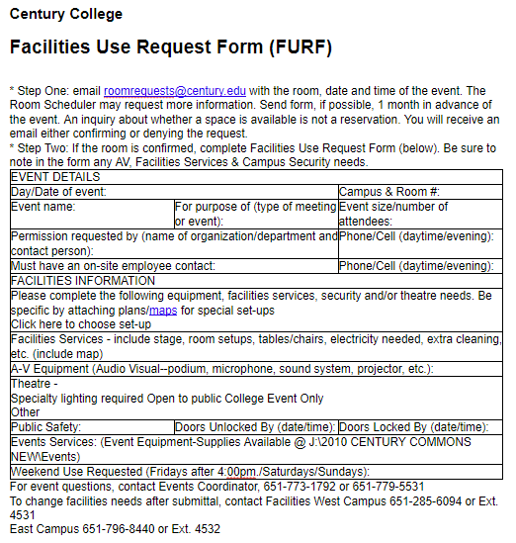
The mission: find open rooms
Received original FURF form (Word Doc)
Build a way for someone to see which rooms are available at a chosen date+time

Slide 3
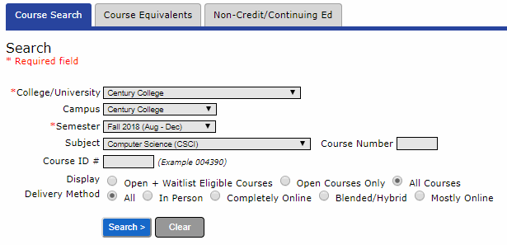
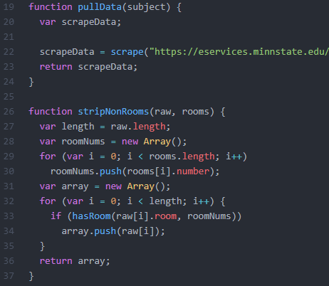
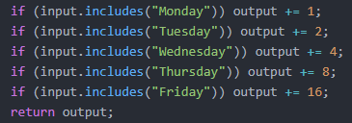
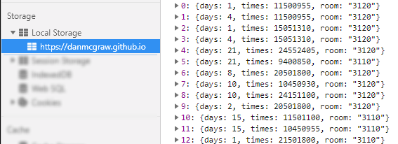
The method: scraper

Slide 4
DEMO

Slide 5
Q & A

Slide 6
Thank You!

